Slide 1
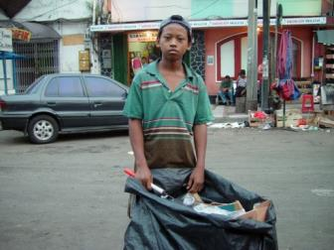
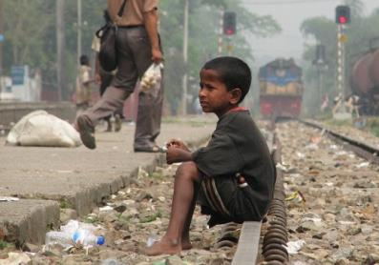
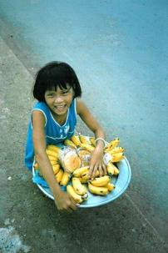
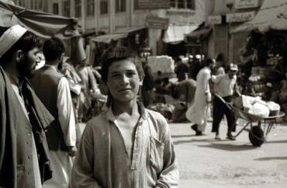
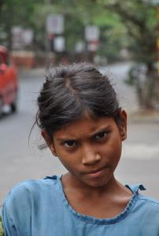
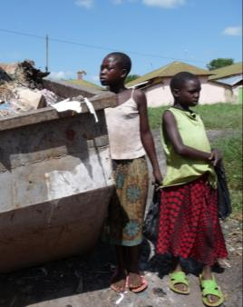
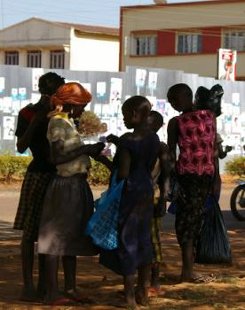
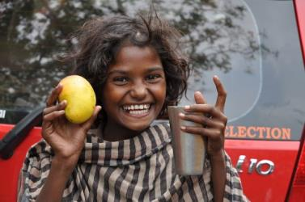
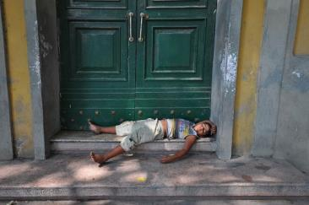
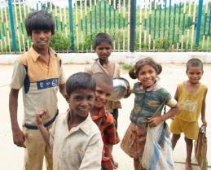
Speech Writing and S.A.L.V.E. International
Lesson 1
Notes:
1

Slide 2
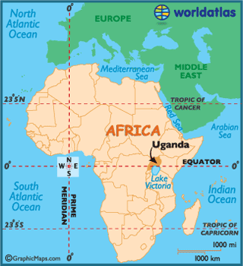
S.A.L.V.E International is a charity that works with children living on the streets in Uganda.
We believe that no child should call the streets home.
Notes:
2

Slide 3
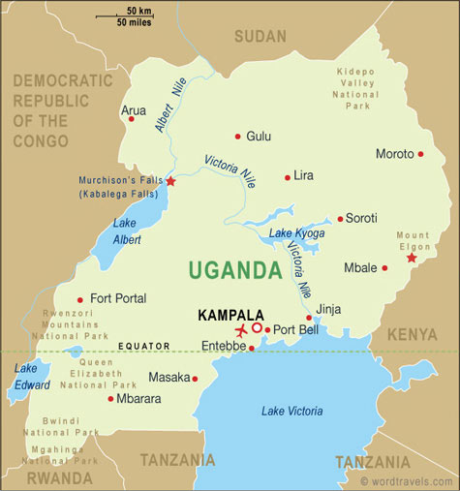
Most of our work is focused in Jinja – a city in the south east of the country
Notes:
3

Slide 4
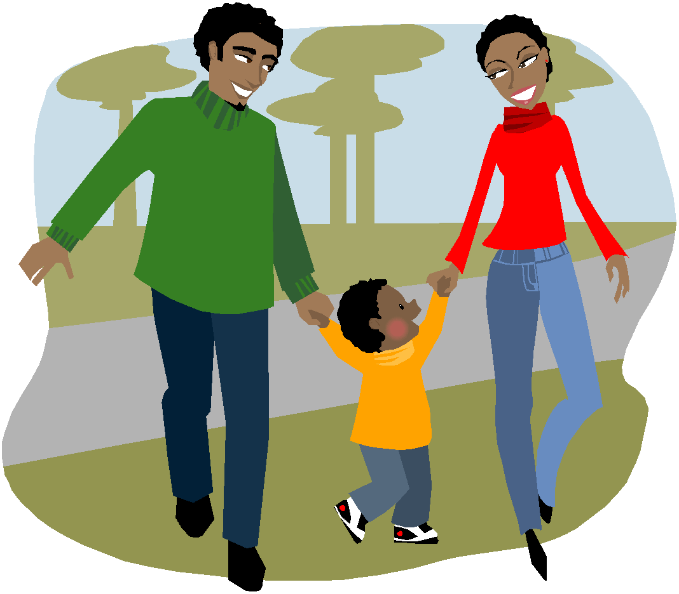
What does S.A.L.V.E do?
Finding Lost Families
Education
Re-homing
Changing the way people think
Notes:
4
-S.A.L.V.E work’s with children living on the streets to rehome them and get them back into education. They work hard to gain the children’s trust so they can better understand what led them to the streets (and thus what might need to be solved for them to go home successfully).
-This can mean taking them back to their families or other relatives or, if they can’t be reunited with their families, taking them to live in the S.A.L.V.E . House temporarily while finding foster care for them where they will be properly looked after.
-Then they focus on sending children to school so they can learn.
-S.A.L.V.E also works hard to change the attitudes of people in Uganda so they stop thinking about children who live on the street as bad and hopeless and start to recognise they are just children who are in a dangerous and difficult position and need help.

Slide 5
‘No Street Called Home’
We believe no child should live on the streets and we are doing our best to make this a reality. You are going to find out more about what we are doing in the next two lessons.
Your task at the end of the two lessons is to write a speech to present on behalf of S.A.L.V.E. to the United Nations Security Council

Slide 6
Key Term Bingo
Copy the table then choose 6 terms from the table and randomly put them in your table.
Alliteration
Fact
Rhetorical question
Repetition
Emotive Language
Repetition
Statistics
Anecdote
Hyperbole
Personal pronouns
Power of three
Superlative
Oxymoron
Notes:
6

Slide 7
A Day in the Life of J
https://youtu.be/k4LUd5an9TU
Watch this clip showing a normal day for J- a boy living on the streets of Jinja.
Note down the following:
Where J sleeps-
What work J does, how long does he work for-
Where J washes-
What J eats-
What drug does J use-
What activity his friend M likes to do-
What is J worried about as he goes to sleep-

Slide 8
A Day in the Life of J
https://youtu.be/k4LUd5an9TU
Where J sleeps- on a step, he uses his refuge sack as a bed cover
What work J does, how long does he work for- sweeping steps, collecting plastic bottles and scrap metal. He works from very early in the morning until late at night.
Where J washes- in a small stream, there is not much privacy
What J eats- he buys some food but also finds food in bins
What drug does J use- Mafuta (aeroplane fuel)
What activity his friend M likes to do- skipping
What is J worried about as he goes to sleep- worried someone will attack him in the night

Slide 9
Sadly, some children experience violence whilst living on the streets of Jinja. You are going to learn a bit about one child’s experience of living on the streets.
Ochen has written a poem about his experiences and uses some of the persuasive writing techniques that were discussed at the start of the class

Slide 10
News From The Streets is a newspaper that is produced by street children in Uganda. In it they show what life on the streets is really like for them, as well as their hopes for the future. You can read the newspaper online on our website S.A.L.V.E International
Ochen’s poem was published in the April 2020 edition

Slide 12
Here are some of the strategies that have been used by Ochen
Power of 3
Emotive language
Repetition of the idea of ‘everywhere’
Personal pronouns
Rhetorical questions

Slide 13
Social Stigma
https://www.youtube.com/watch?v=MQcN5DtMT-0
Watch the video attached which demonstrates the social stigma that millions of children living on the streets experience everyday.
What persuasive writing technique is used at the very end of the video?

Slide 14
The personal pronoun in the sentence is highlighted
‘change starts when you choose to care’

Slide 16
KS3 Speech Writing and S.A.L.V.E International
Lesson 2
Notes:
16

Slide 17
Let's see what you’ve learnt so far
Thumbs up = true
Thumbs down = false

Slide 18
True or False
Approximately 300 children live on the streets of Jinja

Slide 19
True or False
Approximately 300 children live on the streets of Jinja
Approximately 600 children

Slide 20
True or False
There are approximately 3000 more children earning a living on the streets of Jinja

Slide 21
True or False
There are approximately 3000 more children earning a living on the streets of Jinja
These children are not able to go to school and face many dangers when they are on the streets trying to earn money to survive

Slide 22
True or False
Homeless children in Uganda earn money by searching for plastic bottles and selling them

Slide 23
True or False
Homeless children earn money by searching for plastic bottles and selling them
They are the local recycling system

Slide 24
True or False
Homeless children in Jinja usually don’t form strong bonds with other children

Slide 25
True or False
Homeless children in Jinja usually don’t form strong bonds with other children
Children form strong friendships with each other this helps them keep safe and they enjoy playing together when they can

Slide 26
True or False
Homeless children in Jinja are well respected in their communities

Slide 27
Homeless children in Jinja are well respected in their communities
As we saw from the video at the end of last lesson children who -through no fault of their own- look dirty and untidy are often shunned by society.
There are also lots of unfounded negative stereotypes associated with living on the streets in Jinja

Slide 28
True or False
The worst time of day for homeless children is the morning when they wake up feeling hungry

Slide 29
True or False
The worst time of day for homeless children is the morning when they wake up feeling hungry
Nights are the worst. Children fear being attacked, and they can get very cold.

Slide 30
True or False
Children who live on the streets have the same potential as all other children

Slide 31
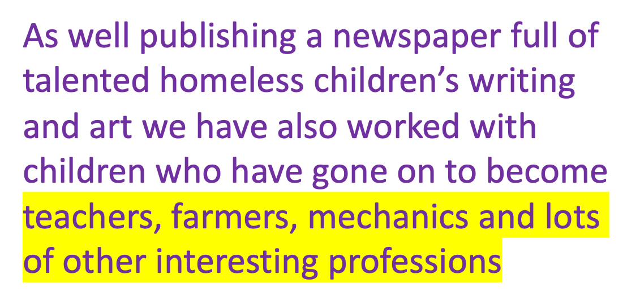
True or False
Children who live on the streets have the same potential as all other children

Slide 32
We believe in unlocking the potential of children living on the streets. Here’s some information about how we go about that.
‘No Street Called Home’
S.A.L.V.E.: https://www.youtube.com/watch?v=J6ikf2HE4yY&feature=youtu.be
During the clip note down as many interventions and programmes run by S.A.L.V.E as you can….

Slide 33
Street Outreach programme. Including; Drop-in centres - clothes washing facilities, counselling, careers advice. Sporting activities organised with other community teams
Halfway Homes and Drug Rehabilitation centre
Education programmes
Family resettlement programme
Parental business skills programme
Education sponsorship (schools are not free in Uganda)

Slide 34
You have been invited to give a speech to the United Nations Security Council on behalf of S.A.L.V.E international explaining why ‘No Street Called Home’ needs to be achieved.
Your speech must cover the following:
The difficulties faced by children on the streets in Uganda
How S.A.L.V.E. is working to reduce the number of children living on the streets
Why this cause should be taken up by the UN
The speech should be 2 mins long
You have 4 minutes to discuss your ideas with your partner - be ready to feedback what you have discussed

Slide 35
Your speech must cover the following:
The difficulties faced by children on the streets in Uganda
How S.A.L.V.E is working to reduce the number of children living on the streets
Why this cause should be taken up by the UN
Complete the planning sheet – you will use this to complete your speech for homework

Slide 36
Homework
Write out your speech in full and practice it ready for next lesson.
You can use the S.A.L.V.E. website to help you and any other reliable resources you can find.
The S.A.L.V.E. webpage address can be found on your planning sheet. TAKE THIS HOME WITH YOU TO HELP YOU STRUCTURE YOUR SPEECH
You will be performing your speech to the class.

Slide 37
Notes:
37

