Slide 1
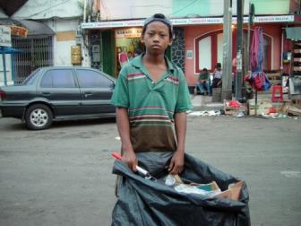
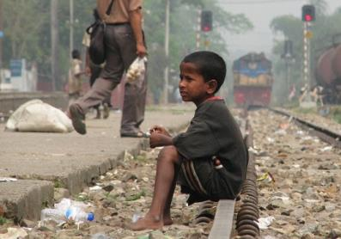
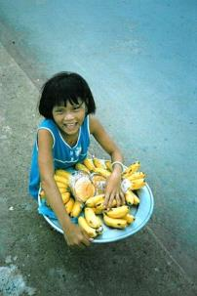
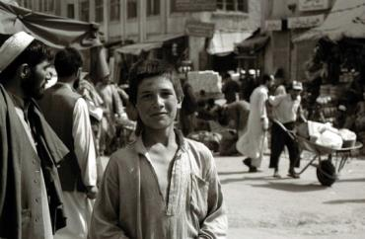
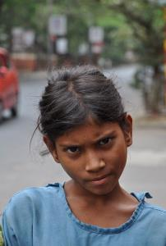
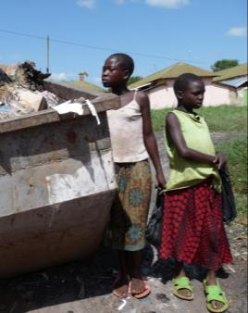
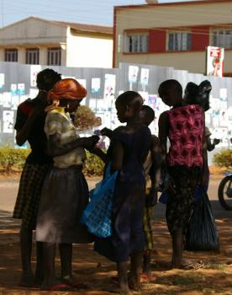
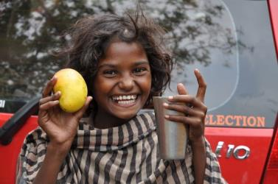
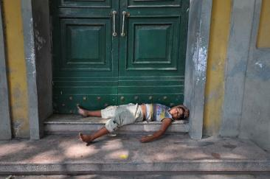
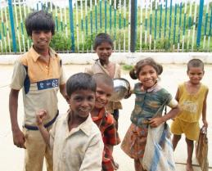
Lesson 2: Introduction to Uganda and Jinja

Slide 2
Activity 1: Children’s Rights and Children on the Street - Recap

Slide 3
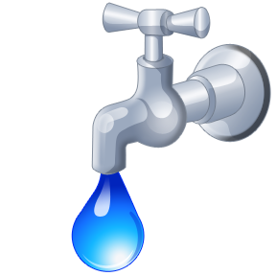


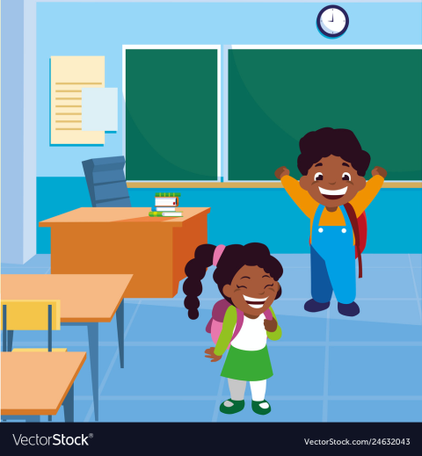
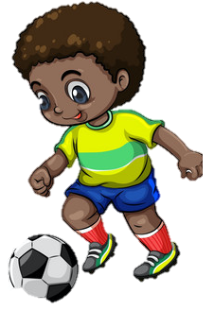

There are some things all children everywhere need to be happy and healthy
Notes:
-There are some things all children everywhere need for healthy development.
-Does anyone remember what these are? (e.g. Clean water, Decent shelter, Education, Allowed to express your opinion, Medical care, Nutritious food, Play, Practise beliefs, culture & language, Clean air, Protection from abuse and neglect, Protection from discrimination).
-The things that children really need we call Children’s Rights.
-These rights are protected by government and the law and everyone – both adults and other children – has a duty to try and make sure all children get the things they need.

Slide 4

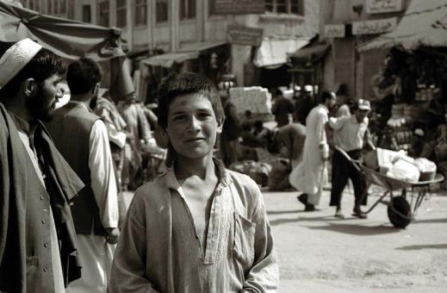
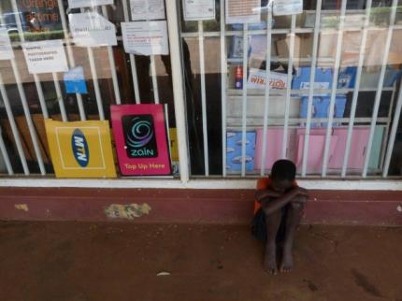
Basic needs are not met
Notes:
-However, for many children around the world, their Children’s Rights are being ignored and their basic needs are not being met.
-This means they are not getting all the important things that they need – like food, shelter and education – to be happy and healthy.
-This is often especially true for children who live on the streets.

Slide 5
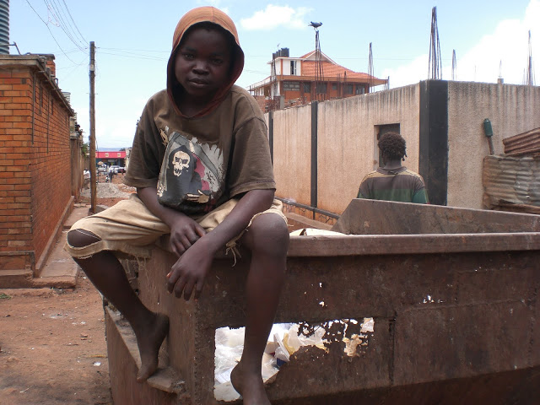
Notes:
-There are an estimated to be millions of children worldwide who live or work on the streets.
- No-one can say exactly how many children live on the streets as many of them try to hide from adults.
-In this lesson we are going to look closely at what life is like for children living on the streets in Jinja, Uganda.

Slide 6
Activity 2: Maps

Slide 7
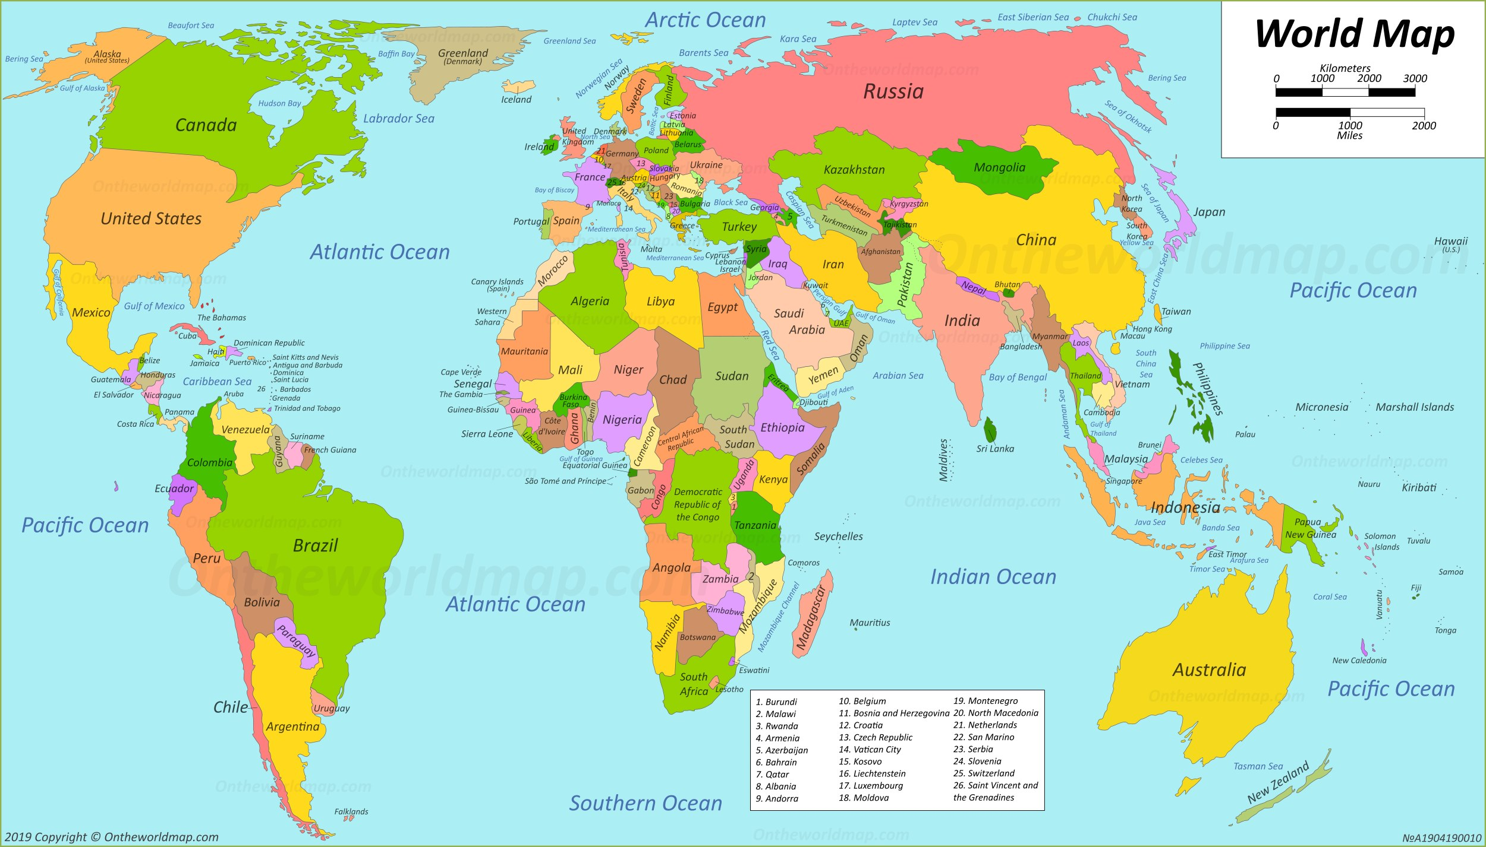

Slide 8
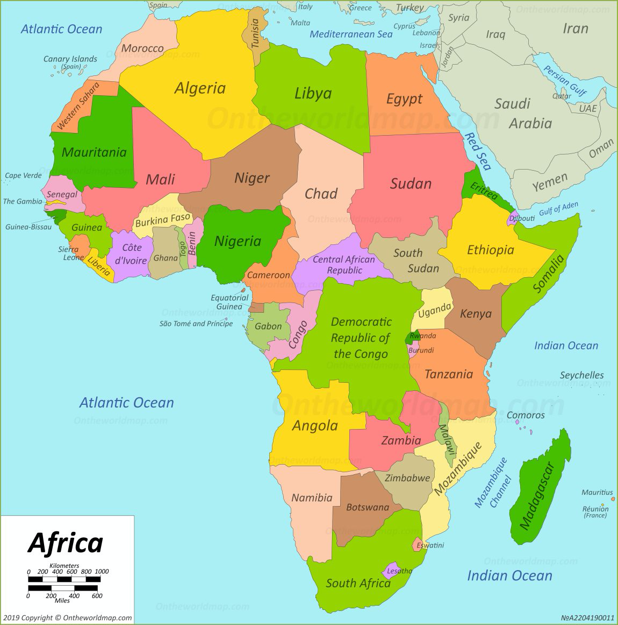

Slide 9
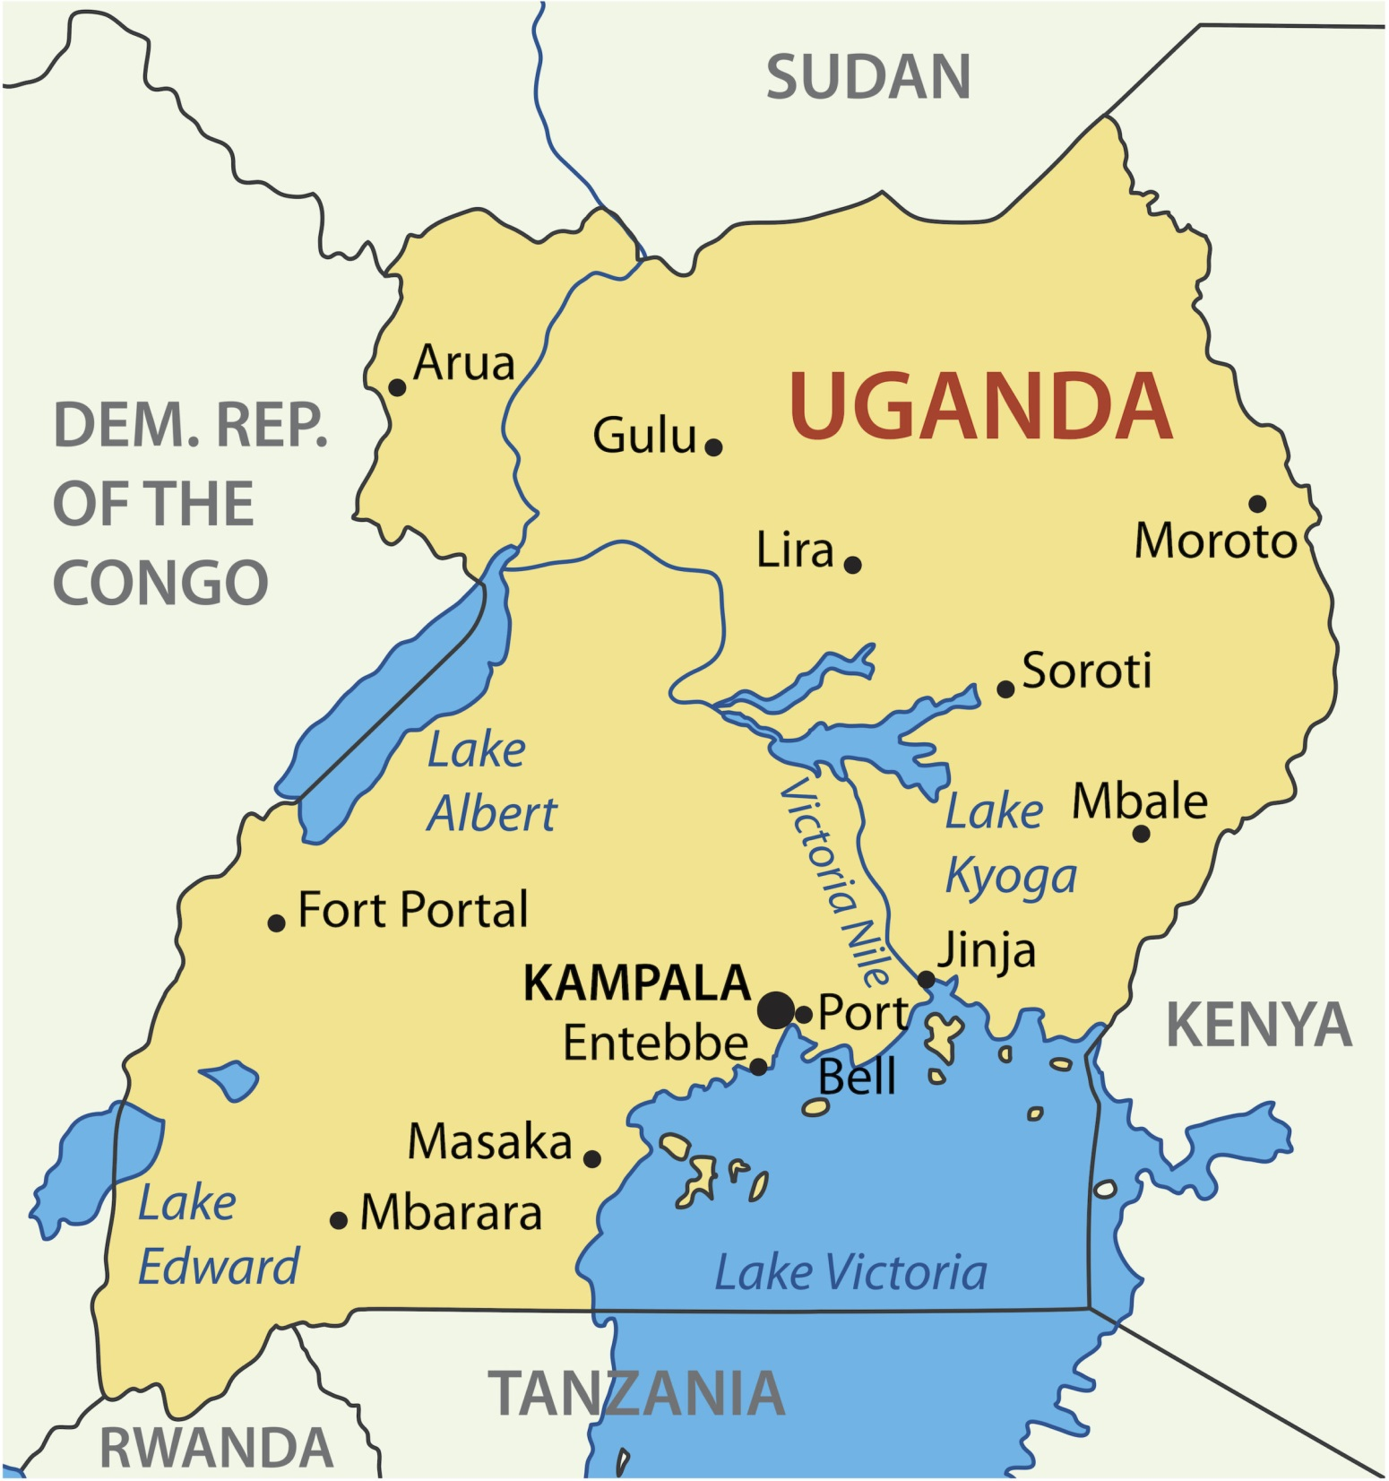

Slide 10
Activity 3: Introduction to Uganda and Jinja

Slide 11
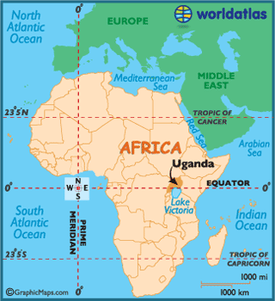
Republic of Uganda
Population: 46 million people
Notes:
-As we have seen Uganda is a country in the continent of Africa.
-Its full name is the Republic of Uganda.
-As you can see on your maps it’s bordered by Kenya, South Sudan, Democratic Republic of Congo, Rwanda and Tanzania.
-The climate of Uganda is tropical, which means it is hot and sunny all year round, with two rainy seasons when there are lots of thunderstorms and two dry seasons which are very dusty.
Population correct at time of writing. Please check https://www.worldometers.info/world-population/uganda-population/ for an up-to-date population

Slide 12
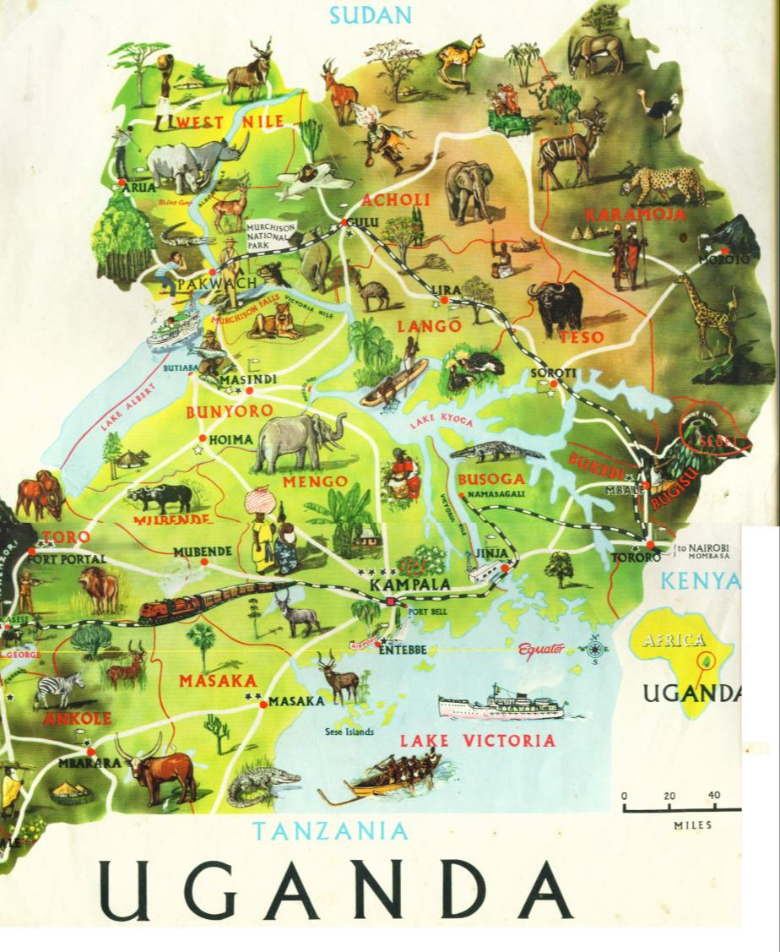
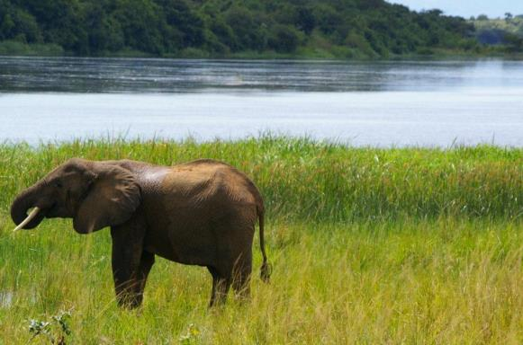
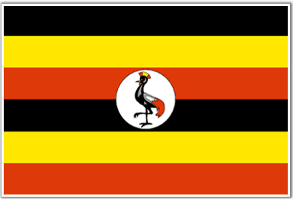
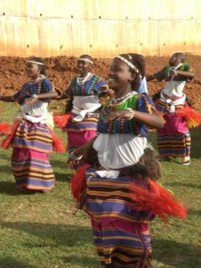
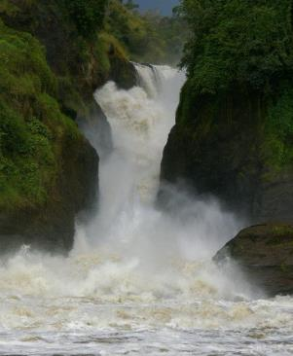
Notes:
-Uganda is a country full of vibrant colours, music and laughter.
-It is famous for the many amazing animals who live there including: elephants, monkeys, cheetahs, leopards, zebras and buffalo.
-The flag of Uganda is stripy, with black, yellow and red stripes and has a Crested Crane (a type of bird) in the middle. The black represents the people of Uganda, the yellow is symbolic of the sunshine, and red represents brotherhood, symbolizing the blood that connects the people of Uganda.

Slide 13
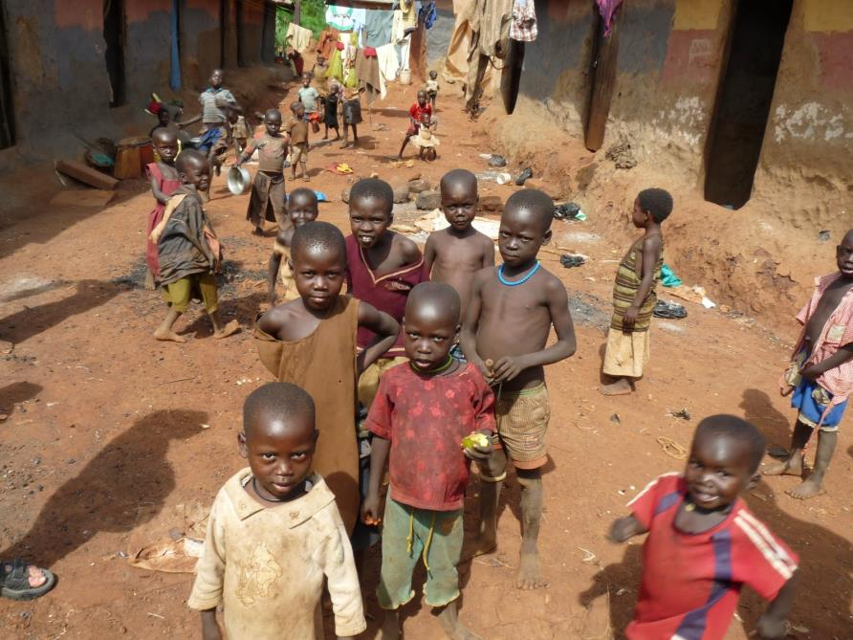
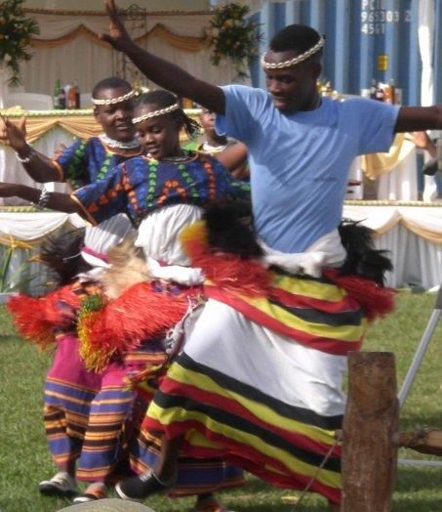
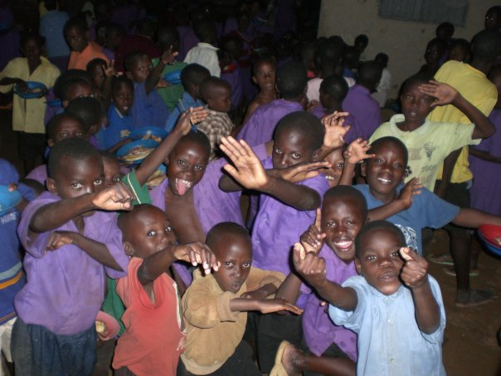
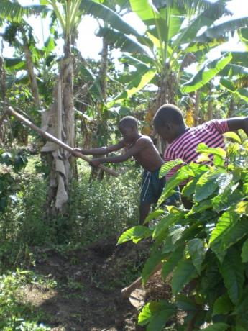
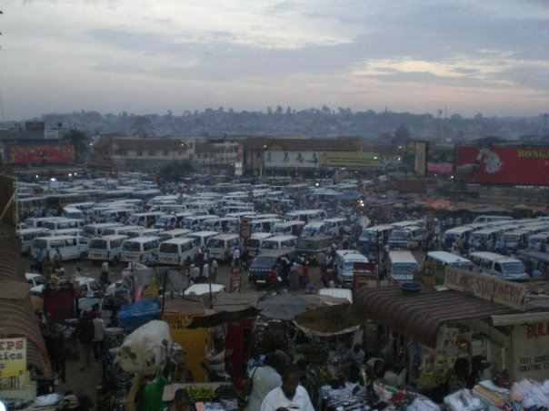
Notes:
-The people of Uganda are famous for being very friendly and hard working.
-They enjoy dancing, music and food and they love football.
-The majority of people work in agriculture.
-Ugandan’s traditionally have big families, with 5 children per family being the average.
-This means there are lots and lots of children in Uganda – in fact over half the population are children.

Slide 14

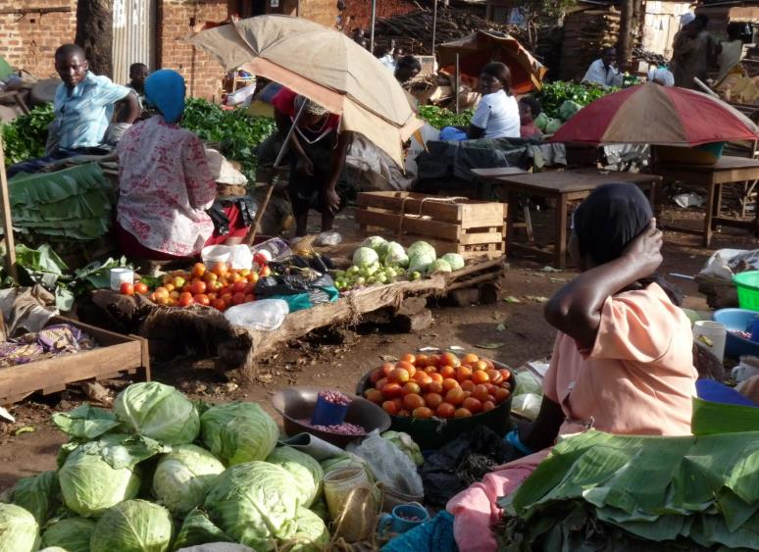
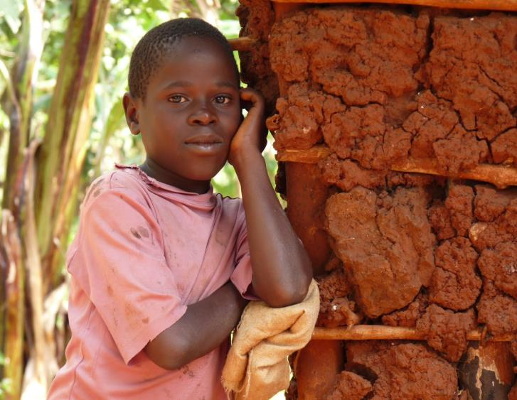
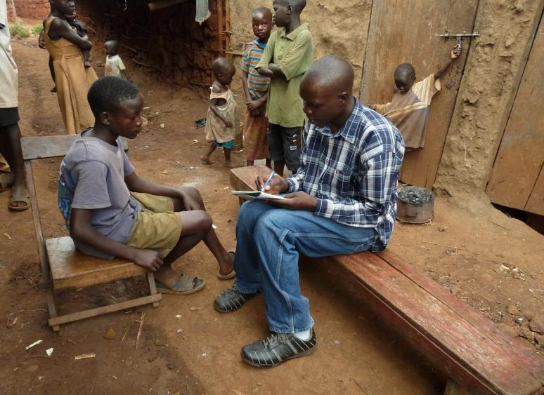
Notes:
-As well as being a beautiful and friendly country, Uganda is also a very poor country – one of the poorer countries in the world.
-Being a poor country has a big effect on the people who live there.
-Some things that we take for granted they cannot afford.
-For example many children die because their parents can’t afford lifesaving medicines for them if they get ill, many adults don’t know how to read or write because they couldn’t afford to go to school, most people don’t have electricity or running water in their homes, only 1% of people will have ever used a flushing toilet.

Slide 15

10 million people in Uganda live on less than 1.50 pound a day….
What can you buy with £1.50?
£1.50 might buy you some sweets, but what about all the other things you need? How can you afford…
Notes:
-8 million people in Uganda live on less than £1.50 a day.
-What can you buy with £1.50? (Sweets, a tin of baked beans, news paper, hair clips… etc)
-How are you supposed to be able to afford: clean water, food for you and your family, rent for your house, medicine for if you get sick, toys to play with, clothes to wear, school fees, money for the bus to go to work?
-On £1.50 a day it is very hard to even afford the most basic things in life.
This gets even more difficult if you have to use the £1.50 to support not only you but your children and other relatives as well.
It becomes very hard to look after yourself and your family even if you are working very hard to do so.

Slide 16
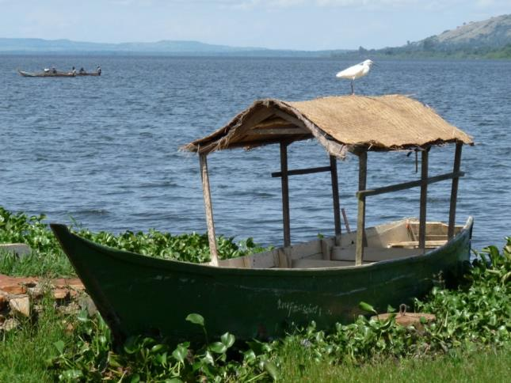
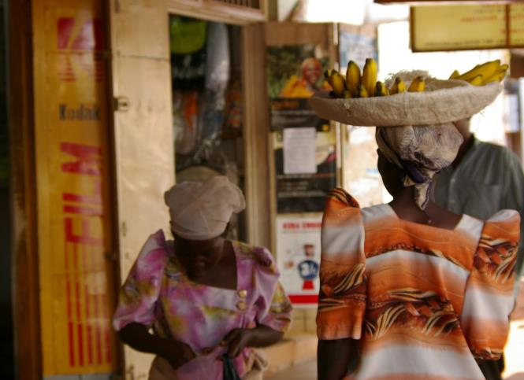
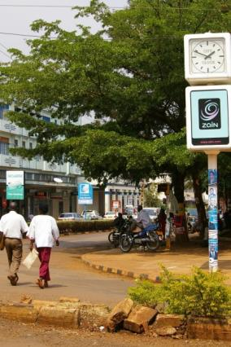
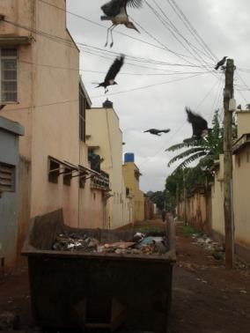
Life in Jinja
Notes:
-Jinja is the second largest city in Uganda
-Find it again on your map of Uganda
-Jinja is on the edge of Lake Victoria and close to the start of the River Nile which goes all the way up to Egypt.

Slide 17
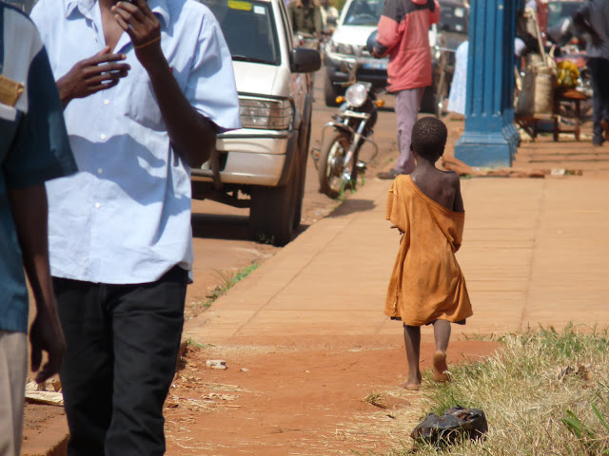
Notes:
-There are many hundreds of children who live on the streets in Jinja.
-Life on the streets is very hard.
-Children on the streets have to try and find safe places to sleep, play and work, as well as trying to find food.
-Often they have to search through bins for something to eat or drink.
-Some people in Jinja think that children living on the streets are bad children because they ran away from home, so they are unkind to them or just ignore them.

Slide 18
