Slide 1
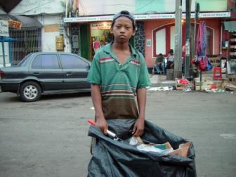
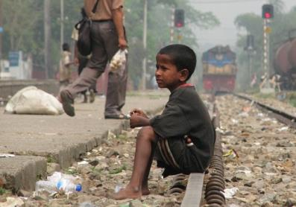
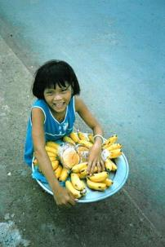
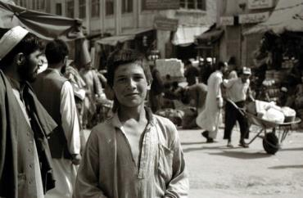
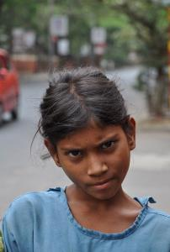
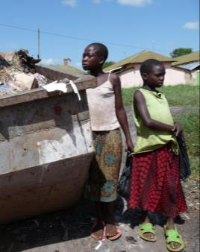
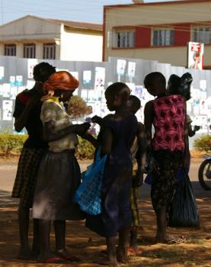
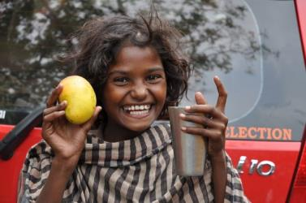
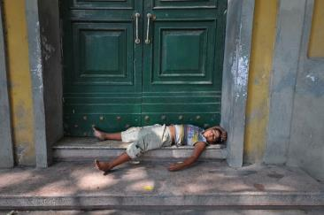
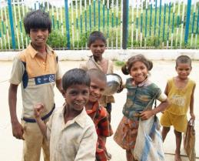
Introducing S.A.L.V.E. International

Slide 2
Uganda and Jinja Recap

Slide 3
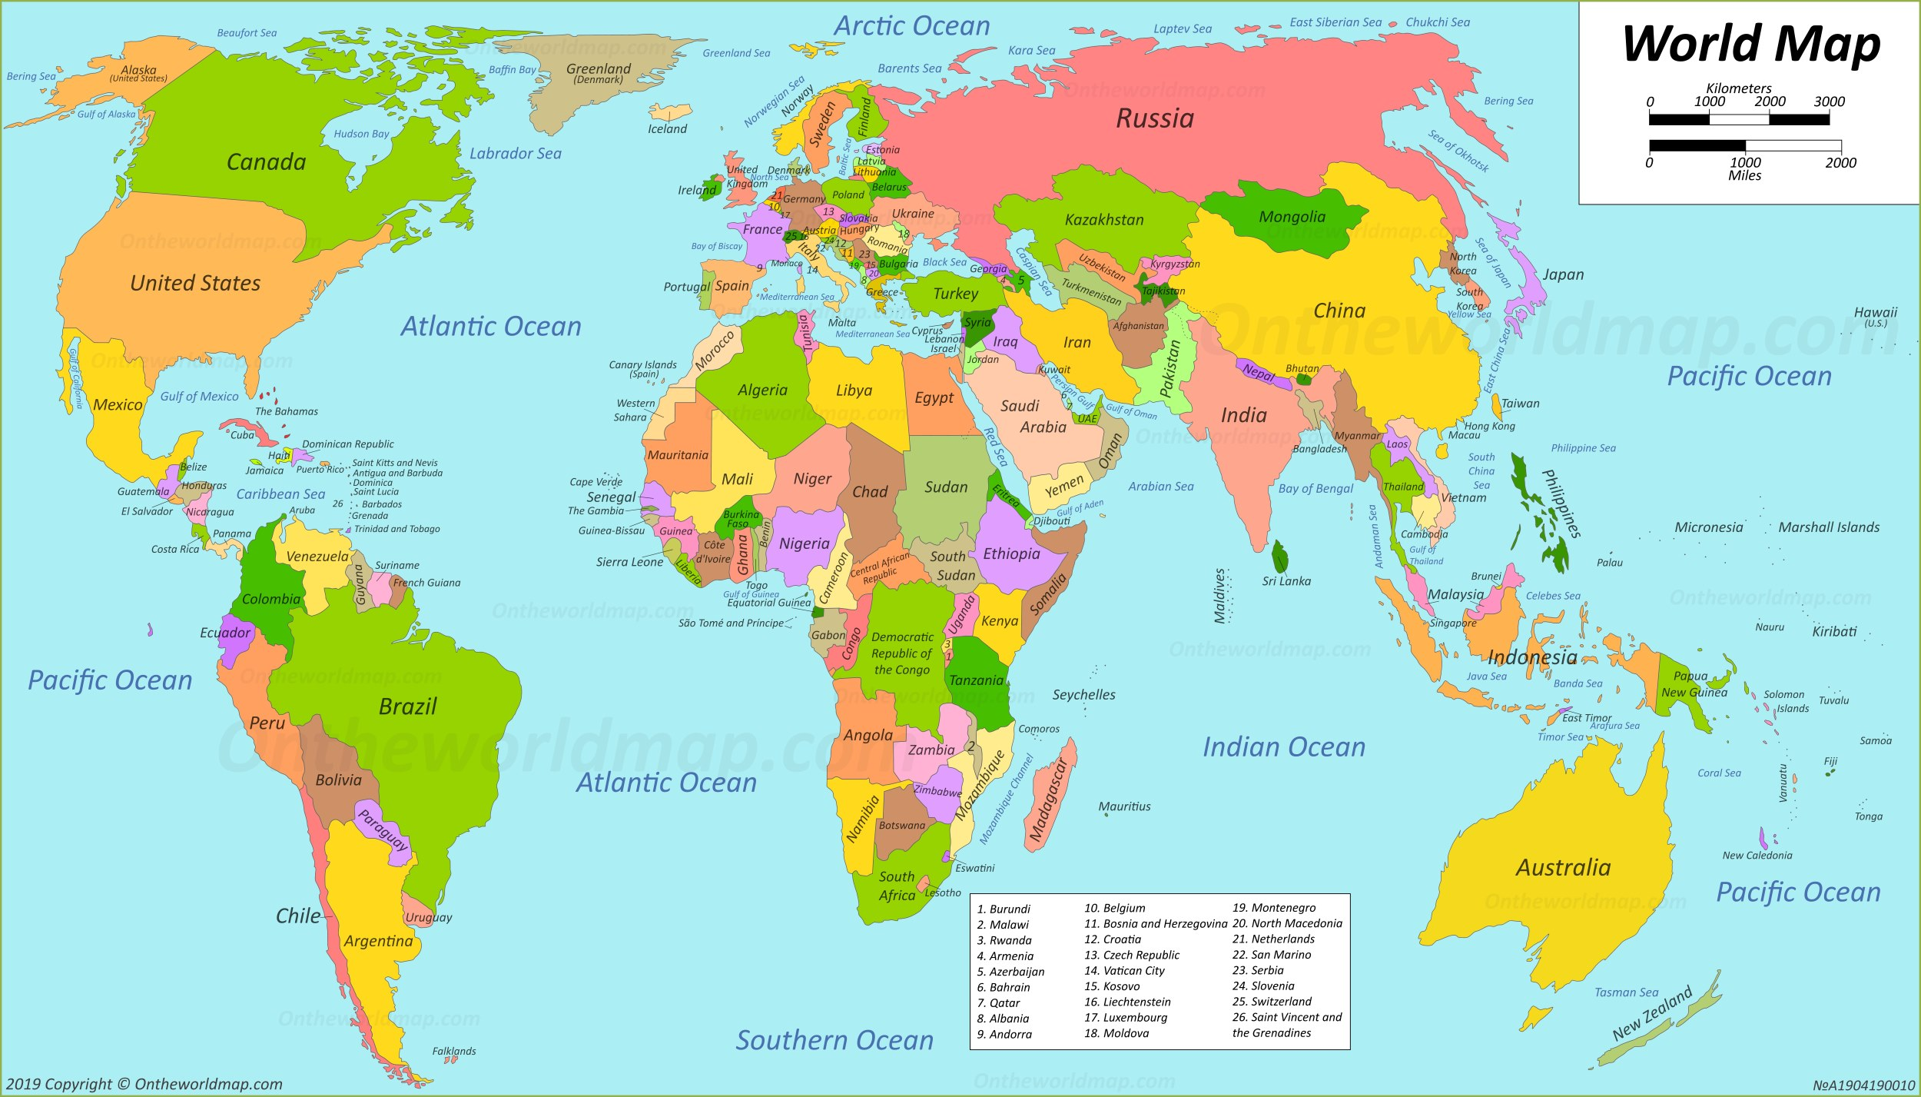
Notes:
-Last time we used maps to find Jinja, a city in Uganda
-Get a pupil to point to Africa, England and Uganda on the map.

Slide 4
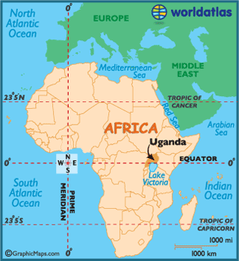
Republic of Uganda
Population: 46 million people
Notes:
-We learnt that Uganda is a country in Africa.
-Uganda is a country full of vibrant colours, music and laughter.
-But Uganda is also one of the poorer countries in the world.
Population correct at time of writing. Please check https://www.worldometers.info/world-population/uganda-population/ for an up-to-date population

Slide 5
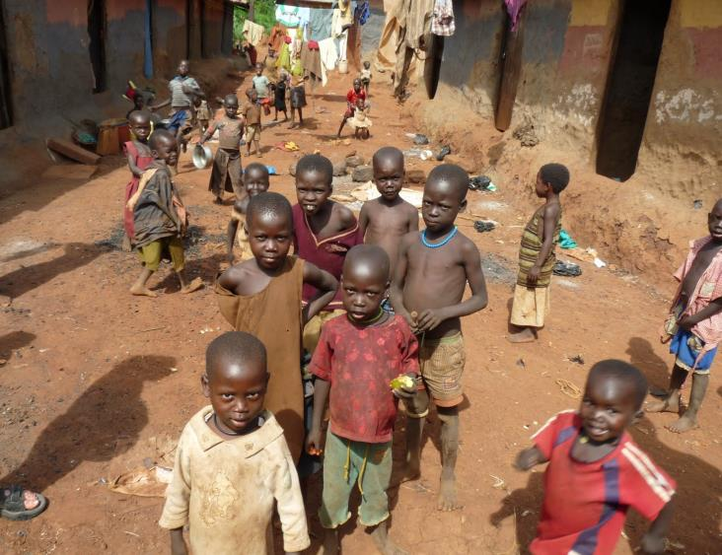
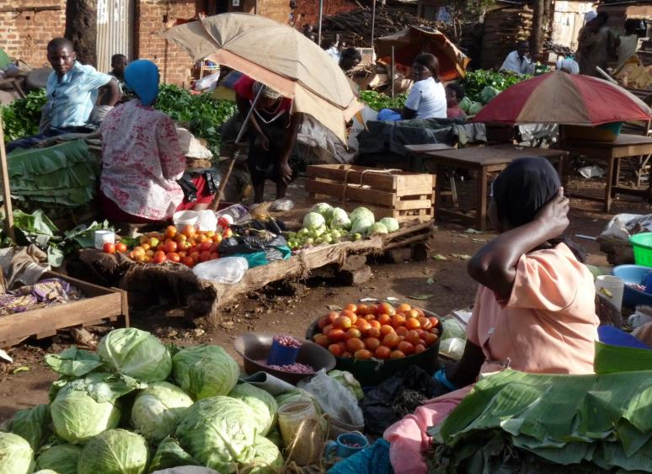
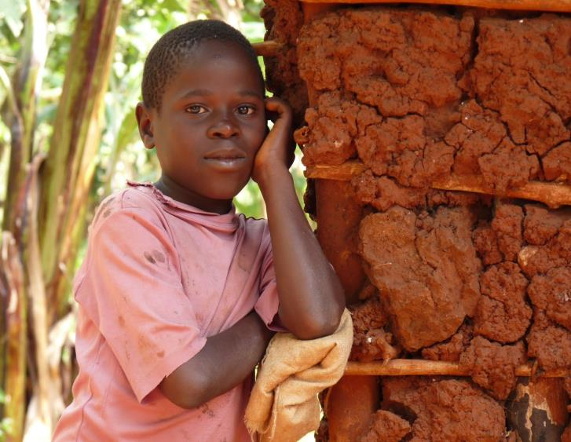
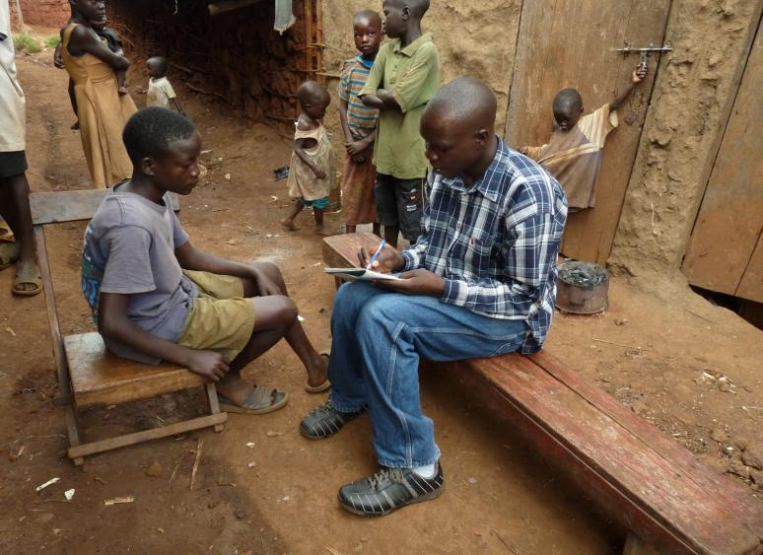
Notes:
-Being a poor country has a big effect on the people who live there.
-Things that we might take for granted they cannot afford such as having to pay for school or to see a doctor.

Slide 6
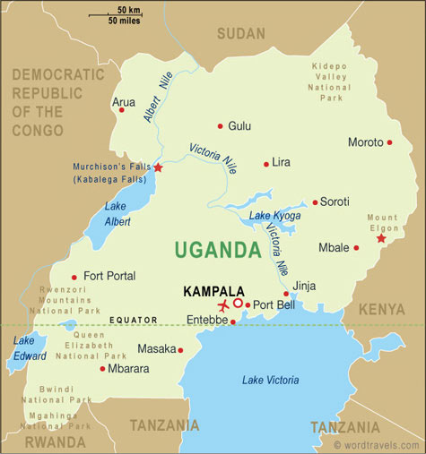
Notes:
-This is a map of Uganda. The city we focussed on last lesson was Jinja. Who can find Jinja?
-There are many children living on the streets in Jinja.

Slide 7
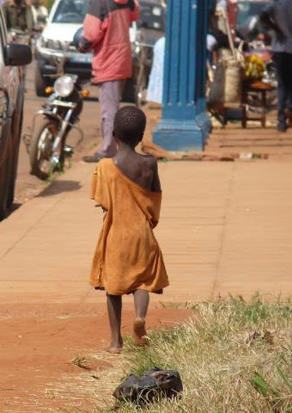
Children live on the streets for many reasons
What are some reasons?
Notes:
-Who can remember some reasons why children have to live on the streets?
(Abused at home, family too poor to look after them, need to work on the street, are orphans or abandoned, peer pressure, need to make money)

Slide 8
Education and S.A.L.V.E

Slide 9
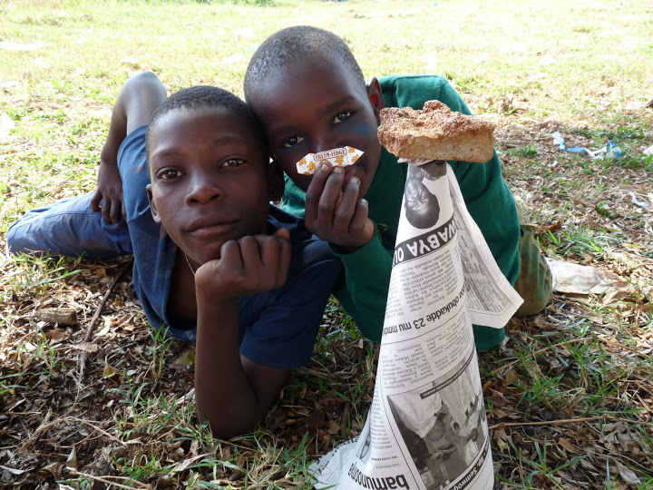
Notes:
-Many people think that children living on the street are bad and naughty, cannot be helped and have no future.
-But when you give children on the street the chance to speak for themselves you hear the opposite. Children living on the streets are just children like any other.
-They like to play, they have hopes and dreams and want to do good things with their lives.

Slide 10
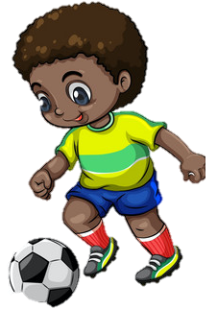
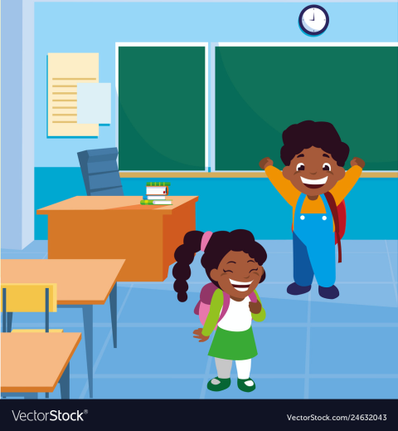
Education is very important
Notes:
-For all children, education is key to being able to achieve those dreams.
-If you live in the UK you can go to school for free from when are you aged 5 to 18
-But in Uganda education is too expensive for many poor children, especially children living on the street.
-If children don’t go to school they cannot learn what they need to get a job or properly prepare themselves to become adults.
Without a job as an adult it will be very hard for them to ever escape a life of poverty and hardship.
This is why getting children who live on the streets back into education is so important

Slide 11
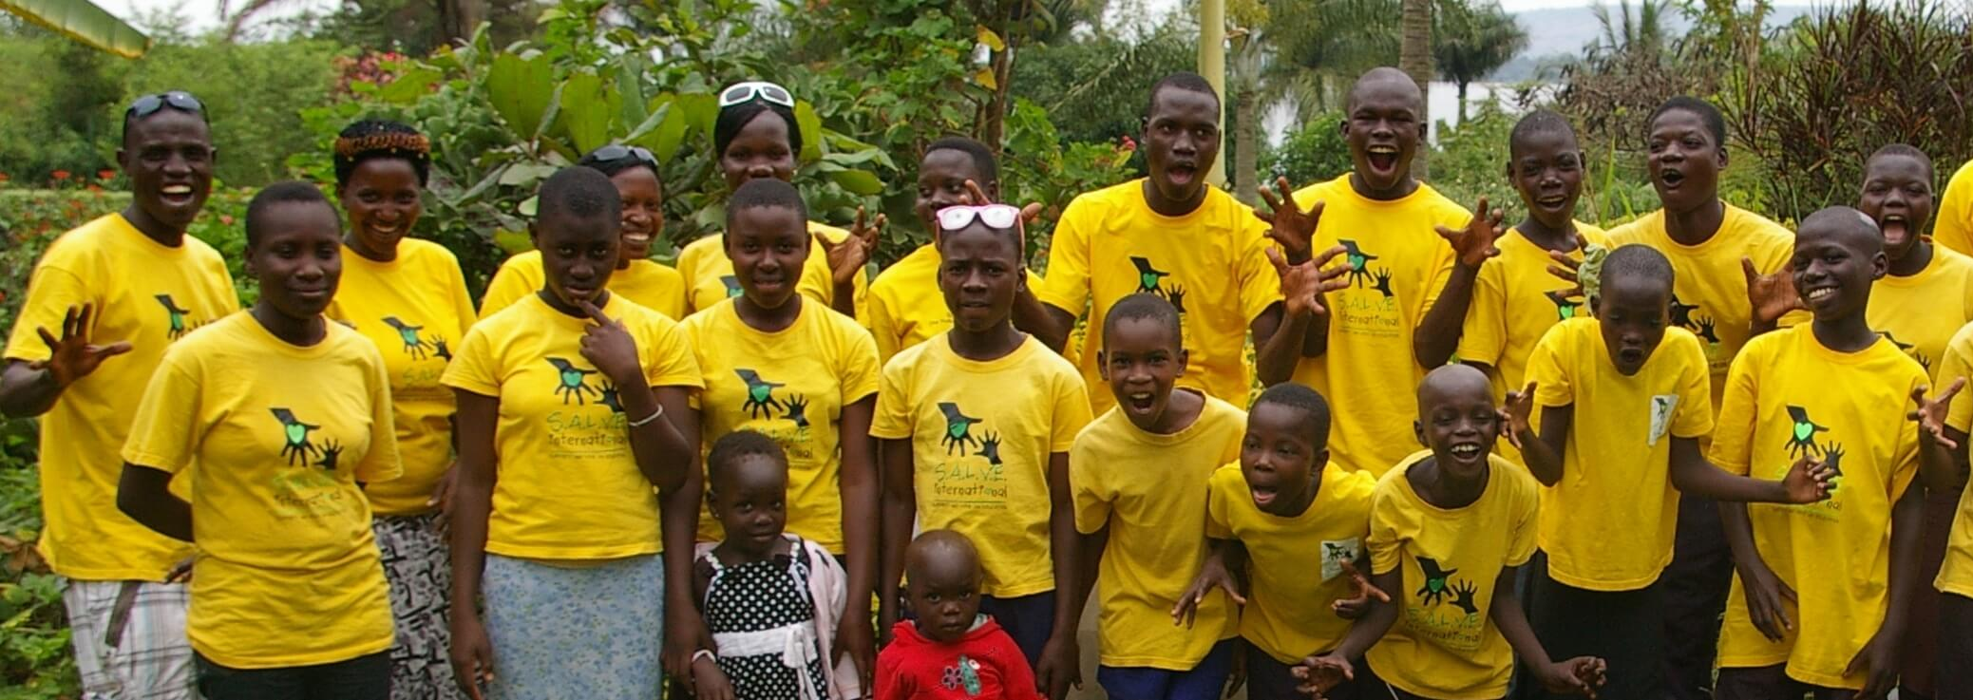
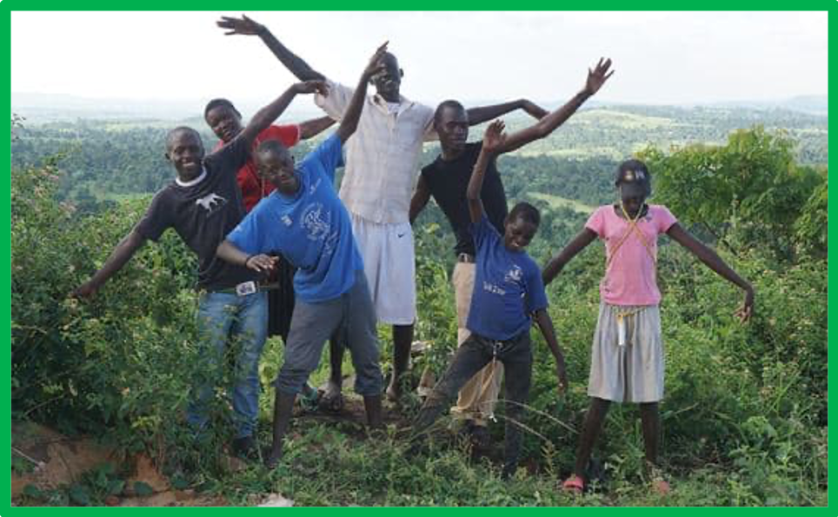
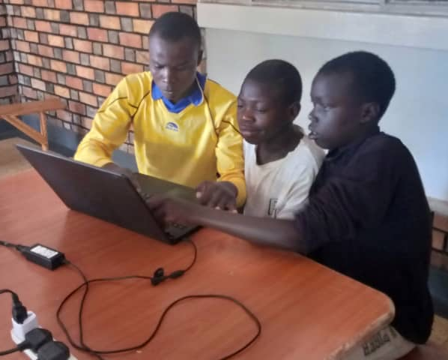
Notes:
-Too often people ignore children living on the street or treat them as bad children.
-But all over the world there are also people trying to help these children.
-In Jinja an organisation called S.A.L.V.E. International is trying to help turn the lives of these children around.

Slide 12

Notes:
-S.A.L.V.E .International is a charity, which means it funded entirely by donations that people give to help the children.
-Does any one know the names of any other charities and what they do? (e.g. Cancer Research, RSPB, NSPCC, Oxfam, National Trust, The Red Cross).

Slide 13
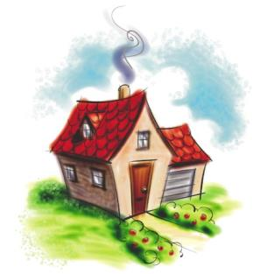
What does S.A.L.V.E do?
Finding Lost Families
Education
Re-homing
Changing the way people think
Notes:
-S.A.L.V.E work’s with children living on the streets to rehome them and get them back into education.
-This can mean taking them back to their families or other relatives or, if they can’t be reunited with their families, taking them to live in the S.A.L.V.E. house temporarily while they find foster care for them where they will be properly looked after.
-Then they focus on sending them to school so they can learn.
-S.A.L.V.E .also works hard to change the attitudes of people so they stop thinking about children who live on the street as bad and hopeless and start to recognise they are just children who are in a dangerous and difficult position and need help.

Slide 14
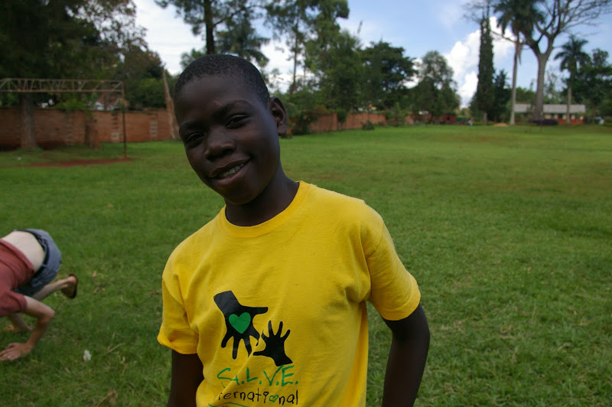
Notes:
-Last week we heard the story of Jacob who used to live on the streets before S.A.L.V.E helped him to turn his life around and get an education.

Slide 15
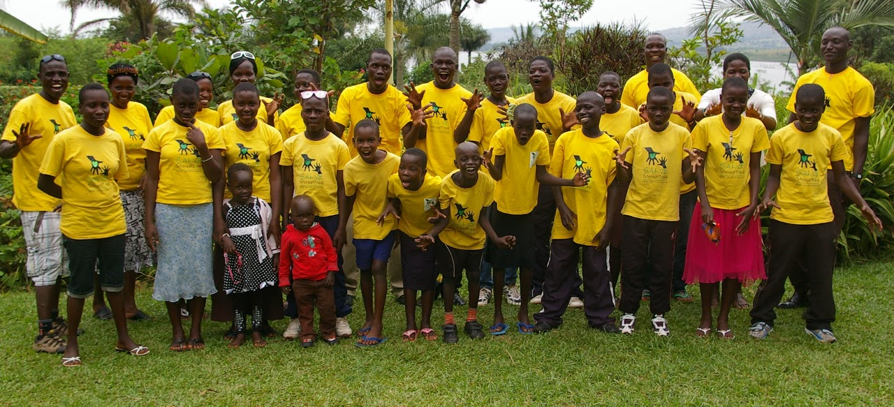
Notes:
-Since it was set up, S.A.L.V.E. has helped get hundreds of children off the street and back with their families or in another loving home such as a foster family.
-They don’t live on the street any more and are properly looked after. Their rights to things like food and shelter are being met.
-They are able to play and do the things they like doing.
-And they are getting an education that will help them build a better future and get jobs.

Slide 16
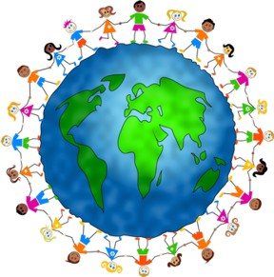
Notes:
-The children who S.A.L.V.E . can help through the kind donations and gifts they are given are the lucky ones.
-But all the children living on the streets in Jinja are so happy you are learning about them and about children on the streets everywhere.
They know it’s so important that people all around the world understand what they go through and recognise they are just children.
The more people know about them and understand their situation, the more likely it is that we can change things for the better.
One day we hope there will be “No Street Called Home” and no child will have to live on the streets.

Slide 17
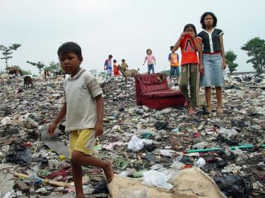
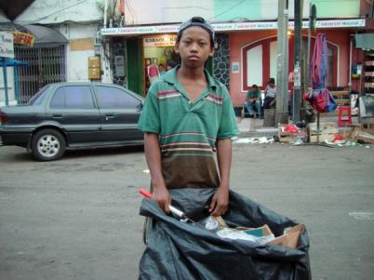
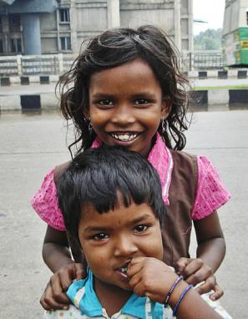
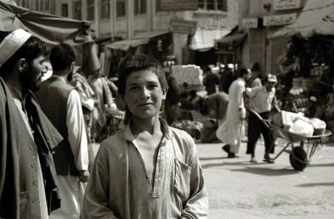

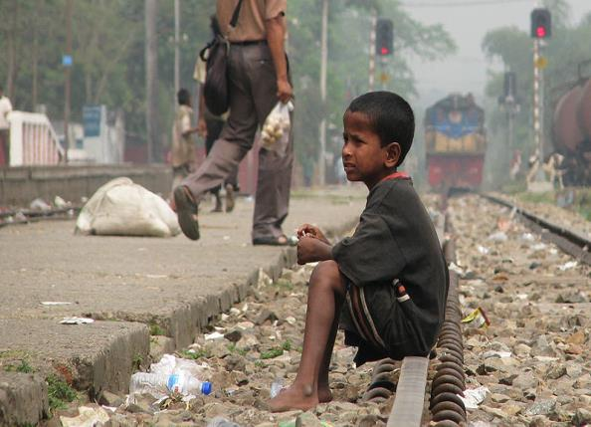

Thank you for learning about our lives!

Slide 18
