Slide 1
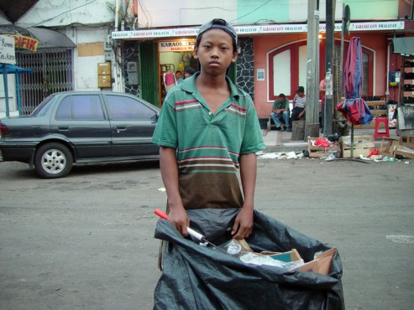
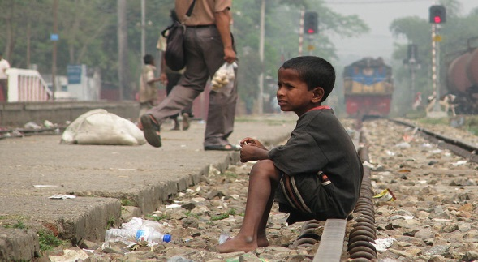
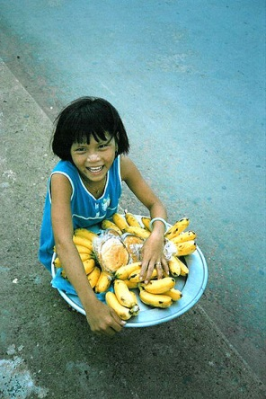
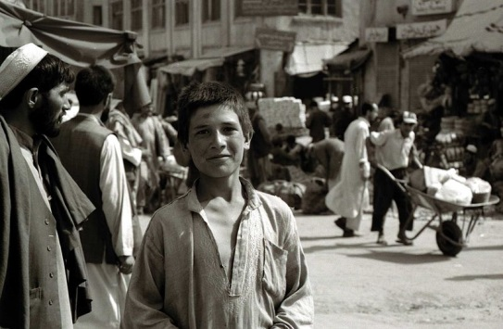
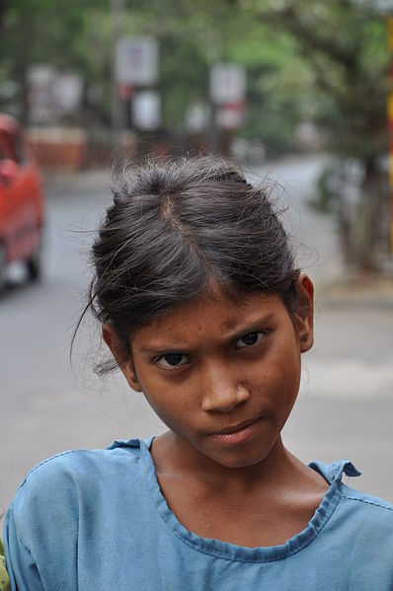
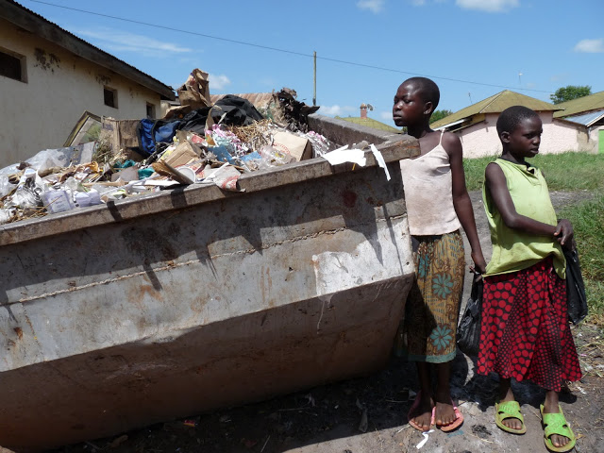
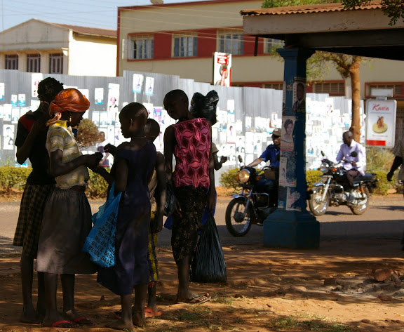
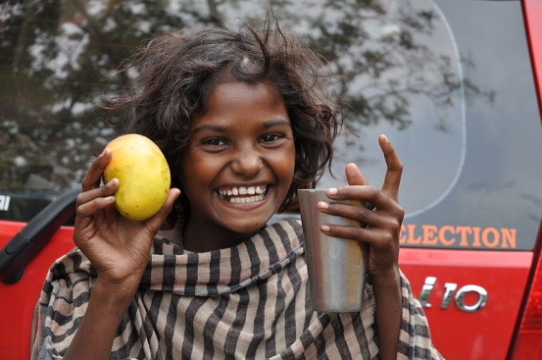
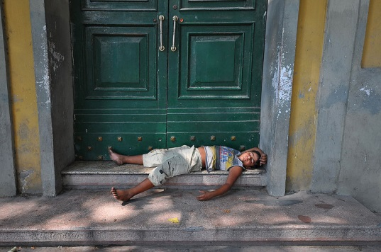
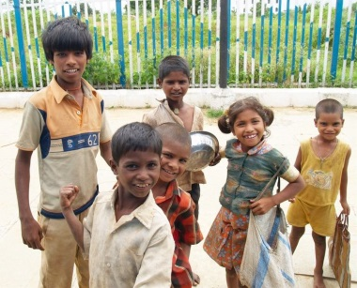
Children on the streets around the World

Slide 2

Who are children on the street?
Notes:
Children on the street are children who live, work, sleep or spend most of their time on the street.
They often don’t have a home to sleep in, can’t go to school and are very vulnerable.
They are also children just like you, they are funny and kind, they love their friends and they have hopes and dreams for the future.
But on the streets they are living in tough and dangerous conditions.

Slide 3
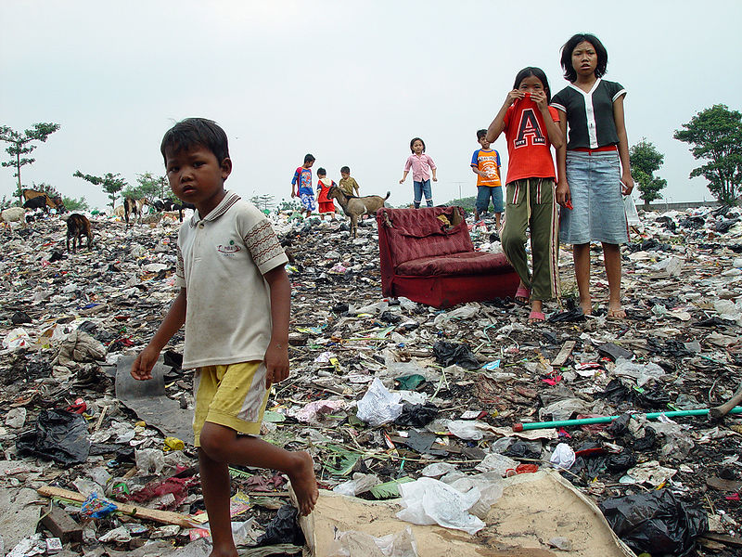

Slide 4
Where are children living on the streets?
Notes:
There are children living on the streets all over the world including in the UK.
The large majority of children on the streets live in poorer countries, for example in some countries in Africa, some parts of Asia and South America.
However some children do live on the streets in richer countries like the USA too.
Some children sleep outside on the streets and other find hidden places to stay in building sites or on the floor at their friend’s house.
Often children who live on the streets are seen as a nuisance in the community, so people don’t always try to help them.

Slide 5


Slide 6
Why are there children living on the street?
Notes:
Children live on the streets for many, many different reasons.
Sometimes their families can’t afford to look after them or send them to school so they have to go out onto the street to work and make money.
Sometimes they are children who have run away from home because their families are cruel to them at home.
Sometimes they are orphans or abandoned children who don’t have anywhere else to go.
Sometimes they run to the streets because they hear it is a chance of a better life and better opportunities than they have at home, though in reality this isn’t the case.

Slide 7
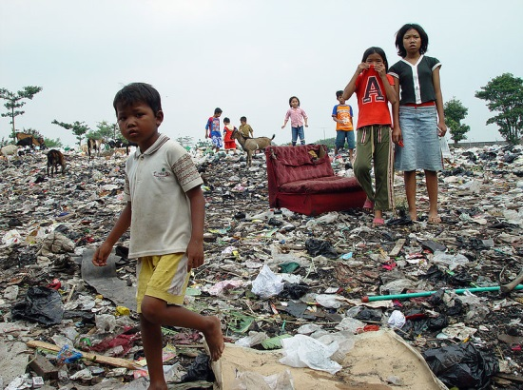
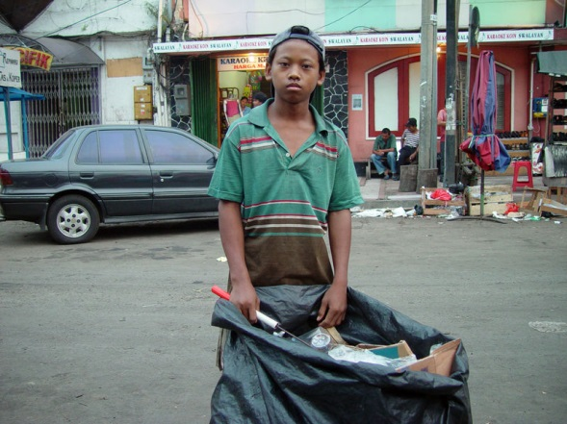
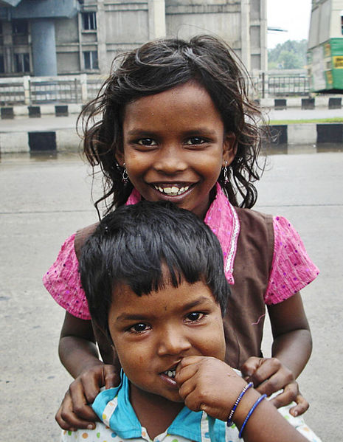
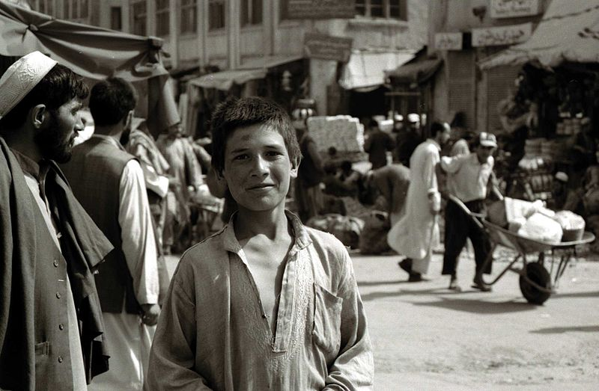
Thank you for learning about our lives!
Notes:
Photo credits for PowerPoint presentation:
Slide 1: (Clockwise from top left): 1. Jonathan McIntosh 2. Tanvirul Islam 3. Zirland 4. Peter Rimar 5. Biswarup Ganguly 6. Esther Dobson 7. Predrag Bubalo 8. Esther Dobson 9. Biswarup Ganguly 10. Sumanth Garakarajula
Slide 2: Sumanth Garakarajula
Slide 3: Jonathan McIntosh
Slide 4: Esther Dobson, Salve International
Slide 5: Tanvirul Islam
Slide 6: Esther Dobson, Salve International
Slide 7: Mike Asiya, Salve International
Slide 8: (Clockwise from top left): 1. Jonathan McIntosh 2. Jonathan McIntosh 3. Arun Ganesh 4. Peter Rimar 5. Esther Dobson 6. Sumanth Garakarajula 7. Tanvirul Islam

Slide 8


