Slide 1
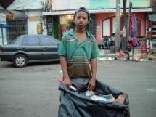
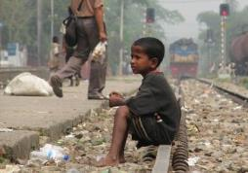
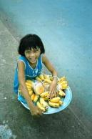
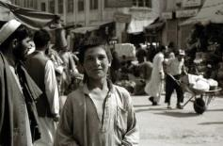
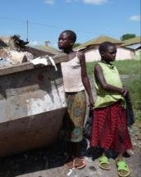
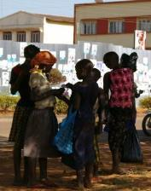
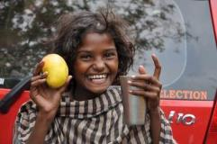
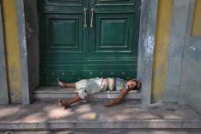
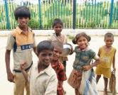
S.A.L.V.E. International
What is Permaculture?

Slide 2
What is Permaculture?

Slide 3
Permaculture is a type of agricultural practice
Lets test your agricultural knowledge…. What fruit/vegetable is being grown in the following pictures

Slide 4
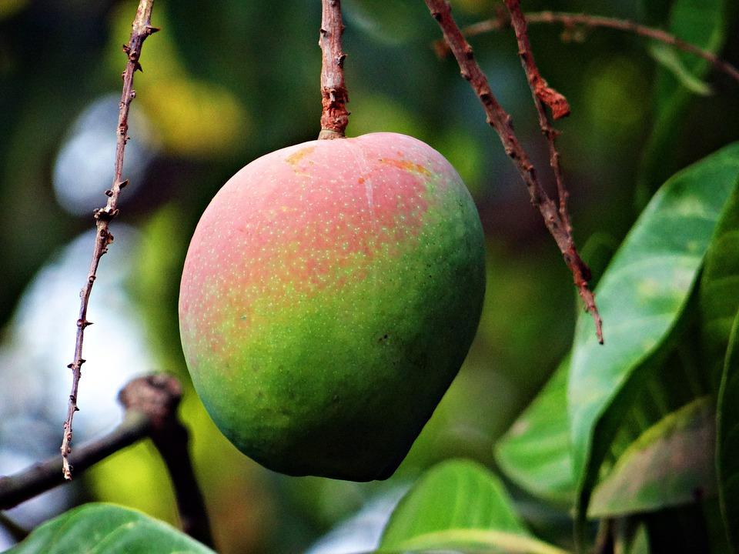
1

Slide 5
Mango

Slide 6
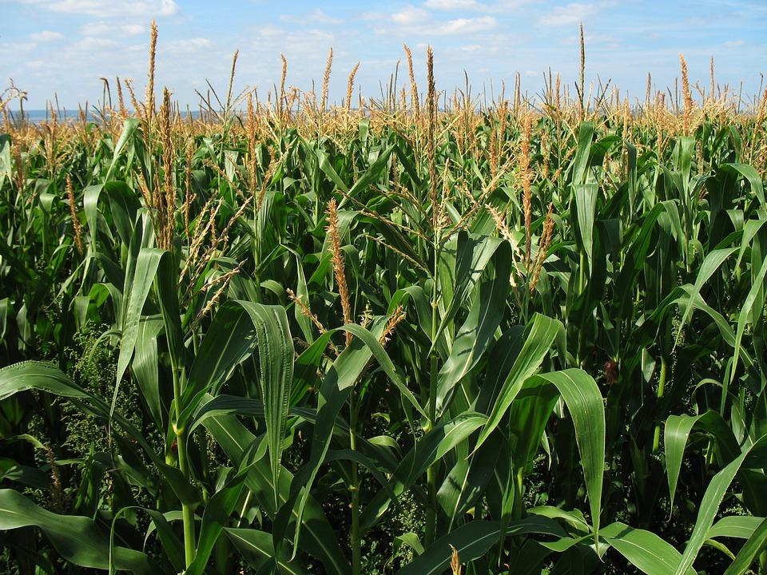
2

Slide 7
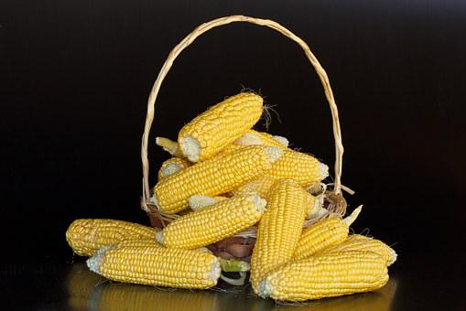
Maise

Slide 8
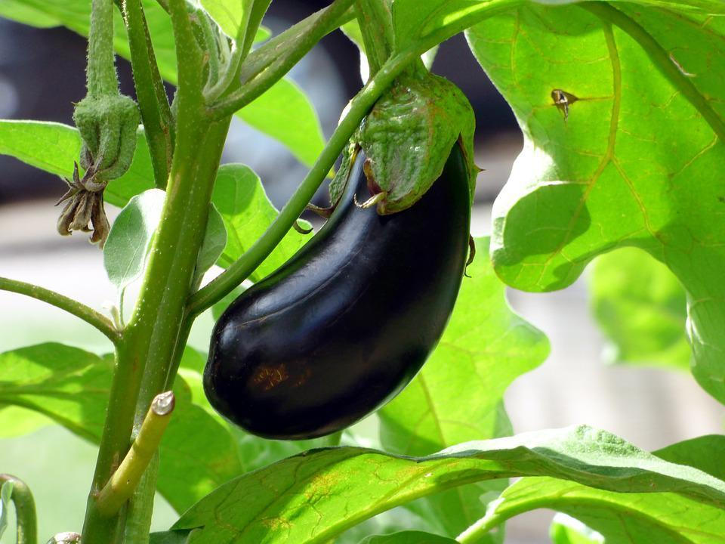
3

Slide 9
Aubergine/
Egg plant

Slide 10
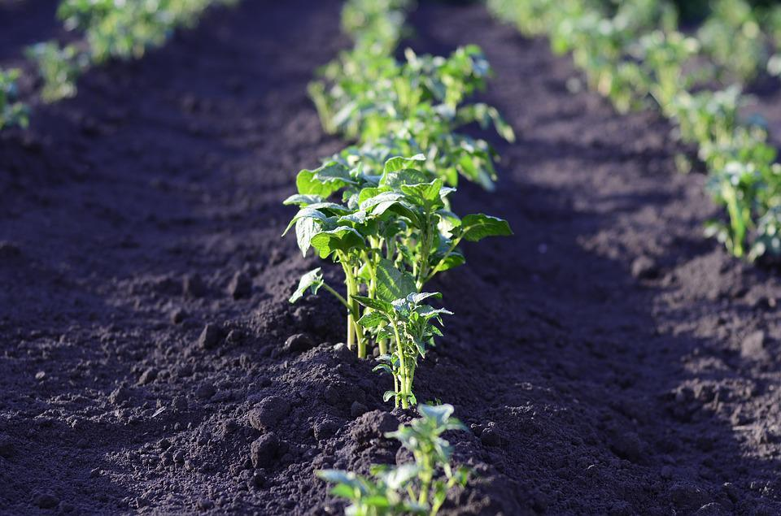
4

Slide 11
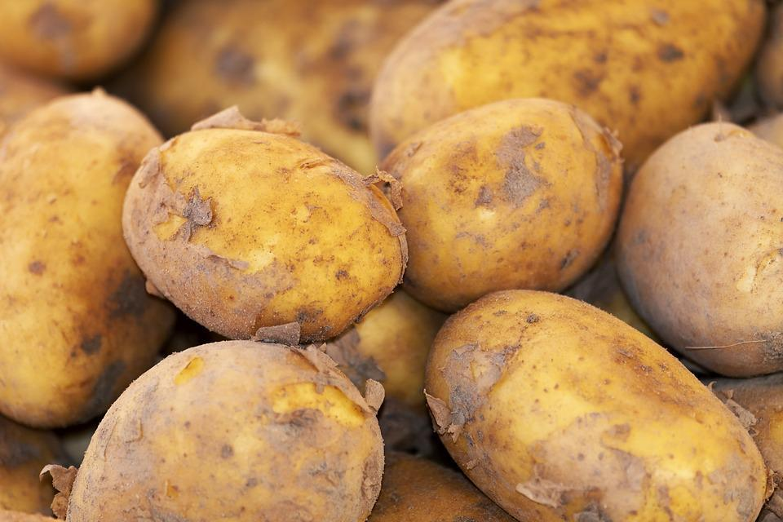
Potatoes

Slide 12
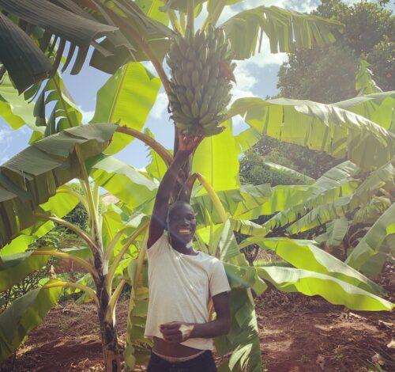
5

Slide 13
Matoke (a savoury type of banana)
These and many other fruit/vegetables and animals are grown/kept on our farm

Slide 14
S.A.L.V.E. International is a charity that is working to eliminate child homelessness in Uganda. The charity aims to resettle street connected children with their families.
This photo was taken on the permaculture farm that is owned and run by S.A.L.V.E. Why does a homeless charity run a farm?
Hint: There’s more than one answer to this

Slide 15
Permaculture at S.A.L.V.E.
The farm is used to educate the children staying at S.A.L.V.E.’s halfway home and drug rehabilitation centres
Children learn new skills which help them to be valued and accepted when they return to their families
This helps them overcome some of the stigma they face after living on the streets
This helps ensure that resettling is a sustainable solution and the child doesn’t return to the streets
Permaculture method involves making the most of the resources you have available to you
The produce produced on the farm is used to feed the children staying at the Halfway Homes/Drug Rehab centre

Slide 16
https://www.youtube.com/watch?v=QXTXNSWOAqQ (older children)
https://www.youtube.com/watch?v=b5dahyWSu0o

Slide 17
Worksheet
Now its time to find out a bit about Permaculture. Fill in the gaps on the worksheet to find out how permaculture works.

Slide 18
Answers to the worksheet ‘fill in the gaps’ activity
Permaculture teaches sustainable farming methods that are vital for a world with an increasing population and changing climate.
The technique is based on using the resources you have in the best possible way. It aims to minimise waste, human labour and energy use.
Some important parts of permaculture are planning how best to use the land available, considering how to best collect and use water and thinking about how to control pests without using chemicals.

Slide 19
At our farm we grow lots of things including:
Matoke
Mangoes
Garlic
Aubergine
Tomatoes
Herbs
Potatoes
We also raise animals, particularly:
Goats
Chickens

Slide 20
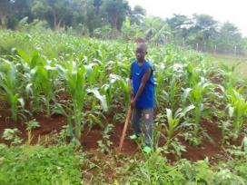
Lucky’s Story
Case study
Read Lucky’s story in groups. Use the
highlighters to show the following
Why Lucky ended up living on the streets
How S.A.L.V.E. staff worked with him while he lived on the streets
What residential care was available for Lucky at S.A.L.V.E.
What he learnt through permaculture lessons
*We normally call children who live on or spend most of their time on the streets ‘street connected’ children*

Slide 21
Lucky’s Story
Case study
Let’s feedback!
Group 1: Why Lucky ended up living on the streets
Group 2: How S.A.L.V.E. staff worked with him while he lived on the streets
Group 3: What residential care was available for Lucky at S.A.L.V.E.
Group 4: What he learnt through permaculture lessons
Can any other groups add any interesting insights into Lucky’s story?

Slide 22
Keyword match up
Draw lines from the keywords on the left to the definitions on the right.

Slide 24
Permaculture and Climate Change

Slide 25
What is COP28? Where is it being held?

Slide 26
COP28 is….
The United Nations annual climate change conference
It’s being held in Dubai, UAE, 30 November – 12 December 2023

Slide 27
COP28
Heads of state, ministers, climate activists and business leaders will gather to discuss and to agree on actions on many things including:
Reducing greenhouse gas emissions
Building resilience to and adapting to the impacts of climate change
Financing climate action in developing countries
Resilience = the ability to recover quickly from a difficulty
Financing = providing the money for something

Slide 28
Climate Change and Permaculture
Permaculture is brilliant at doing the following
Reducing greenhouse gas emissions
Building resilience to and adapting to the impacts of climate change
Therefore, we want Permaculture to be more widely used and understood.
Your task is therefore to write a letter to the COP28 delegates to explain why permaculture should be promoted in farming
Delegates = the representatives who attend a conference

Slide 29
It’s good to use some persuasive writing techniques when writing a letter like this….can you think of any examples of techniques?

Slide 30
Key Term Bingo
Copy the table then choose 6 terms from the table and randomly put them in your table.
Alliteration
Fact
Rhetorical question
Repetition
Emotive Language
Repetition
Statistics
Anecdote
Hyperbole
Personal pronouns
Power of three
Superlative
Oxymoron

Slide 31
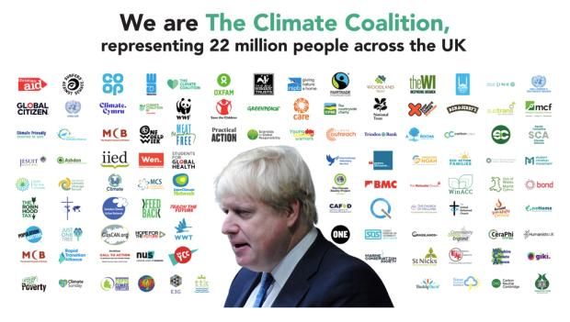
Persuasive writing techniques are useful when writing a letter.
Look at the letter written by the climate coalition to Boris Johnson when he was Prime Minister for COP27.
In your groups annotate all the ways the group uses persuasive writing techniques

Slide 32
Here are some examples of persuasive techniques from the letter…. You might have found more examples.
Personal pronouns (used throughout the poem)
Prime Minister,
This is your chance to leave an historic legacy.
Wild weather, raging fires, deadly floods and rising seas are sweeping the globe. They’re caused by human-made emissions and the destruction of nature, and they’re devastating lives here and across the world.
The damage we’re doing to rainforests, oceans and our own countryside means there are some sights our grandchildren will never see and some cultures that will be lost forever.
Lives and livelihoods are already being torn apart in communities on the frontlines of the crisis.
Lots of examples of emotive language

Slide 33
Statistic – this linked to a YouGov tracker result on the original website
The public’s concern about climate change has reached an all-time high [1]. We expect you to protect our future. Your success or failure will be written about in the history books.
You could be remembered for agreeing a global plan to cut emissions to stop the world heating by more than 1.5℃, and leading by example in the UK by drawing the fossil fuel era to a close.
You could be remembered for leading global commitments to restore and protect nature in the next decade, and leading by example in the UK by building back our woodland and peatlands that capture carbon and slow down climate change.
You could be remembered for ensuring there is financial support to meet the scale of the impacts faced by the people and communities most affected by climate change globally, and leading by example in the UK by investing to create new green jobs.
Power of 3

Slide 34
Superlative
Failing to face the biggest existential threat since World War II will be no legacy at all. Will you deliver an historic climate deal that respects the contract between this generation and the next?
Yours sincerely,
The Climate Coalition, representing 22 million people across the UK
Rhetorical Question

Slide 35
Now it’s your turn…
Case study
Read through the article entitled ‘Learning lifelong skills’
In your groups: Note down 3 information points from the text about permaculture or about this particular case study. Try to use a persuasive writing technique for each point.

Slide 36
Now it’s your turn…
Case study
Read through the article entitled ‘Learning lifelong skills’
In your groups: Note down 3 information points from the text about permaculture or about this particular case study. Try to use a persuasive writing technique for each point.

Slide 37
Now it’s your turn…
Case study
Read through the article entitled ‘Learning lifelong skills’
In your groups: Note down 3 information points from the text about permaculture or about this particular case study. Try to use a persuasive writing technique for each point.
Let’s feed back

Slide 38
Let’s recap the keywords
We need a volunteer…..
You have 1 min to describe as many key words as possible
You can’t use the keyword or any derivatives of it in your description

Slide 39
Permaculture, Climate Change and COP28

Slide 40
Let's see what you’ve learnt
Thumbs up = true
Thumbs down = false

Slide 41
Permaculture is a form of farming where only vegetables are grown

Slide 42
Permaculture is a form of farming where only vegetables are grown

Slide 43
S.A.L.V.E. International runs a permaculture farm and teaches permaculture techniques to street connected children in Uganda

Slide 44
S.A.L.V.E. International runs a permaculture farm and teaches permaculture techniques to street connected children in Uganda

Slide 45
Permaculture involves minimizing waste, human labour and energy use

Slide 46
Permaculture involves minimizing waste, human labour and energy use

Slide 47
Lucky was given seeds, a water butt and 3 chickens by S.A.L.V.E. to take home to his village when he returned to live with his mother

Slide 48
Lucky was given seeds, a water butt and 3 chickens by S.A.L.V.E. to take home to his village when he returned to live with his mother
Permaculture relies on using available local materials and growing crops/caring for animals that are best suited to the local area and condition, rather than trying to grow/keep standard plants/animals

Slide 49
Permaculture is brilliant at doing the following:
Reducing greenhouse gas emissions
Making farmers rich

Slide 50
Permaculture is brilliant at doing the following:
Reducing greenhouse gas emissions
Building resilience to and adapting to the impacts of climate change
It can also produce an income for farmers or can be used to produce food for families

Slide 51
Permaculture requires little skill that’s why we taught it to Sam and children like him

Slide 52
Permaculture requires little skill that’s why we taught it to Sam and children like him
The more skills permaculture farmers have the better the results they produce

Slide 53
Pests are controlled without using chemicals

Slide 54
Pests are controlled without using chemicals
Lots of different methods are used to control pests including:
Using/encouraging animal predators like frogs, lizards and ducks
Attracting beneficial insects
Growing plants that attract pests away from the crops
Barriers and manual methods – like hand picking snails

Slide 55
COP28 is….
The United Nations annual climate change conference
It’s being held in Dubai, UAE, 30 November – 12 December 2023
It’s time to write your letters explaining why permaculture is so important to the delegates

Slide 56
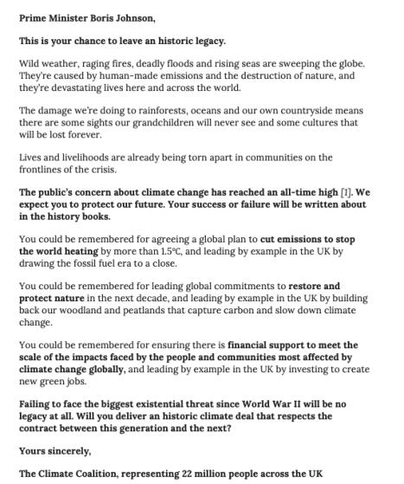
What is missing/wrong with this letter format?
You have 2 mins to discuss with the person next to you

Slide 57
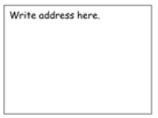
How to layout a formal letter
What sort of ideas should each paragraph contain?
Paragraph 1 Explain why you are writing the letter
Add more detail. Add information about successful case studies here.
Yours sincerely -if you know their name
Yours faithfully – if you don’t know their name
Summarise your main points for writing the letter

Slide 58
Now discuss with the person next to you what main points you want to include in your letter to the United Nations. Be ready to feed back 3 points each. You have 5mins
Your letter must cover the following:
What permaculture is
How and why S.A.L.V.E. uses permaculture to help street-connected children
Why permaculture should be encouraged by the UN
The letter should be 1 A4 sheet long

Slide 59
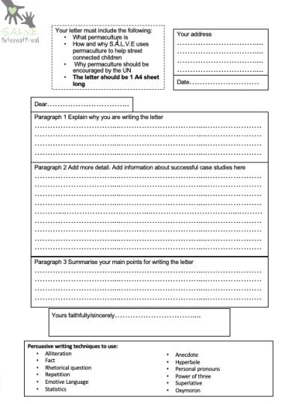
Use the letter template to plan out your letter
Complete the planning sheet – you will use this to complete your letter for homework
It is likely that the Prime Minister Liz Truss will attend Cop 27 so address your letter to her.

Slide 60
Homework
Write out your letter in full on a new sheet of paper ready for next lesson.
You can use the S.A.L.V.E website/COP28 website to help you and any other reliable resources you can find.
Both webpage addresses can be found on your planning sheet. TAKE THIS HOME WITH YOU TO HELP YOU STRUCTURE YOUR LETTER.
We will be sending our letters next lesson!

Slide 62
Notes:
-S.A.L.V.E International is a charity, which means it funded entirely by donations that people give to help the children.
-Does any one know the names of any other charities and what they do? (e.g. Cancer Research, RSPB, NSPCC, Oxfam, National Trust, The Red Cross).

